Slide 1
Introduction to Information Retrieval
Introduction to
Information Retrieval
Lecture 7: Text Classification;
The Naive Bayes algorithm
Based on: “Information Retrieval and Web Search” prepared
by Pandu Nayak and Prabhakar Raghavan

Slide 2
Standing queries
Introduction to Information Retrieval
Ch. 13
The path from IR to text classification:
You have an information need to monitor, say:
Unrest in the Niger delta region
You want to rerun an appropriate query periodically to find new news items on this topic
You will be sent new documents that are found
I.e., it’s not ranking but classification (relevant vs. not relevant)
Such queries are called standing queries
Long used by “information professionals”
A modern mass instantiation is Google Alerts
http://www.google.com/alerts
Standing queries are (hand-written) text classifiers

Slide 3
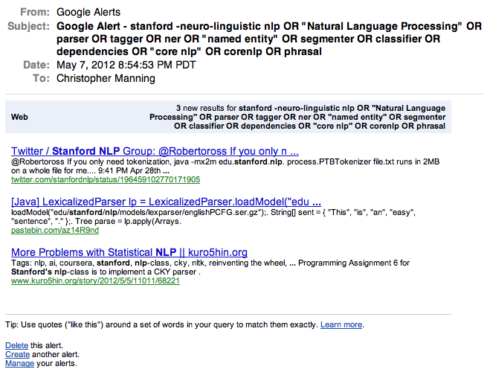
Introduction to Information Retrieval
3

Slide 4
Spam filtering Another text classification task
Introduction to Information Retrieval
Ch. 13
From: "" <takworlld@hotmail.com>
Subject: real estate is the only way... gem oalvgkay
Anyone can buy real estate with no money down
Stop paying rent TODAY !
There is no need to spend hundreds or even thousands for similar courses
I am 22 years old and I have already purchased 6 properties using the
methods outlined in this truly INCREDIBLE ebook.
Change your life NOW !
=================================================
Click Below to order:
http://www.wholesaledaily.com/sales/nmd.htm
=================================================

Slide 5
Text classification
Introduction to Information Retrieval
Ch. 13
Today:
Introduction to Text Classification
Also widely known as “text categorization”
Same thing
Naïve Bayes text classification
Including a little on Probabilistic Language Models

Slide 6
Categorization/Classification
Introduction to Information Retrieval
Sec. 13.1
Given:
A description of an instance, d ∈ X
X is the instance language or instance space.
Issue: how to represent text documents.
Usually some type of high-dimensional space – bag of words
A fixed set of classes:
C = {c₁, c₂,…, c_{J}}

Slide 7

Categorization/Classification
Introduction to Information Retrieval
Sec. 13.1
Determine:
The category of d: γ(d) ∈ C, where γ(d) is a classification function whose domain is X and whose range is C.
We want to know how to build classification functions (“classifiers”).

Slide 8
Machine Learning: Supervised Classification
Introduction to Information Retrieval
Sec. 13.1
Given:
A description of an instance, d ∈ X
X is the instance language or instance space.
A fixed set of classes:
C = {c₁, c₂,…, c_{J}}
A training set D of labeled documents with each labeled document ⟨d,c⟩ ∈ X×C
Determine:
A learning method or algorithm which will enable us to learn a classifier γ:X→C
For a test document d, we assign it the class γ(d) ∈ C

Slide 9
Document Classification
Introduction to Information Retrieval
Sec. 13.1
“planning
language
proof
intelligence”
Test
Data:
(AI)
(Programming)
(HCI)
Classes:
ML
Planning
Semantics
Garb.Coll.
Multimedia
GUI
Training
Data:
learning
intelligence
algorithm
reinforcement
network...
planning
temporal
reasoning
plan
language...
programming
semantics
language
proof...
garbage
collection
memory
optimization
region...
...
...
(Note: in real life there is often a hierarchy, not present in the above problem statement; and also, you get papers on ML approaches to Garb. Coll.)

Slide 10
More Text Classification Examples
Introduction to Information Retrieval
Ch. 13
Many search engine functionalities use classification
Assigning labels to documents or web-pages
Labels may be:
topics such as Yahoo-categories
"finance," "sports," "news>world>asia>business"
genres
"editorials" "movie-reviews" "news”
opinion on a person/product
“like”, “hate”, “neutral”
domain-specific
Recommendation => "interesting-to-me" : "not-interesting-to-me”
Content filter => “contains adult language” : “doesn’t”
Language detection => language identification: English, French, Chinese, …
Search vertical => about Linux versus not
Spam filter => “link spam” : “not link spam”

Slide 11
Classification Methods (1)
Introduction to Information Retrieval
Ch. 13
Manual classification
Used by the original Yahoo! Directory
Looksmart, about.com, ODP, PubMed
Very accurate when job is done by experts
Consistent when the problem size and team is small
Difficult and expensive to scale
Means we need automatic classification methods for big problems

Slide 12
Classification Methods (2)
Introduction to Information Retrieval
Ch. 13
Hand-coded rule-based classifiers
One technique used by CS dept’s spam filter, Reuters, CIA, etc.
It’s what Google Alerts is doing
Widely deployed in government and enterprise
Companies provide “IDE” for writing such rules
E.g., assign category if document contains a given boolean combination of words
Commercial systems have complex query languages (everything in IR query languages +score accumulators)
Accuracy is often very high if a rule has been carefully refined over time by a subject expert
Building and maintaining these rules is expensive

Slide 13
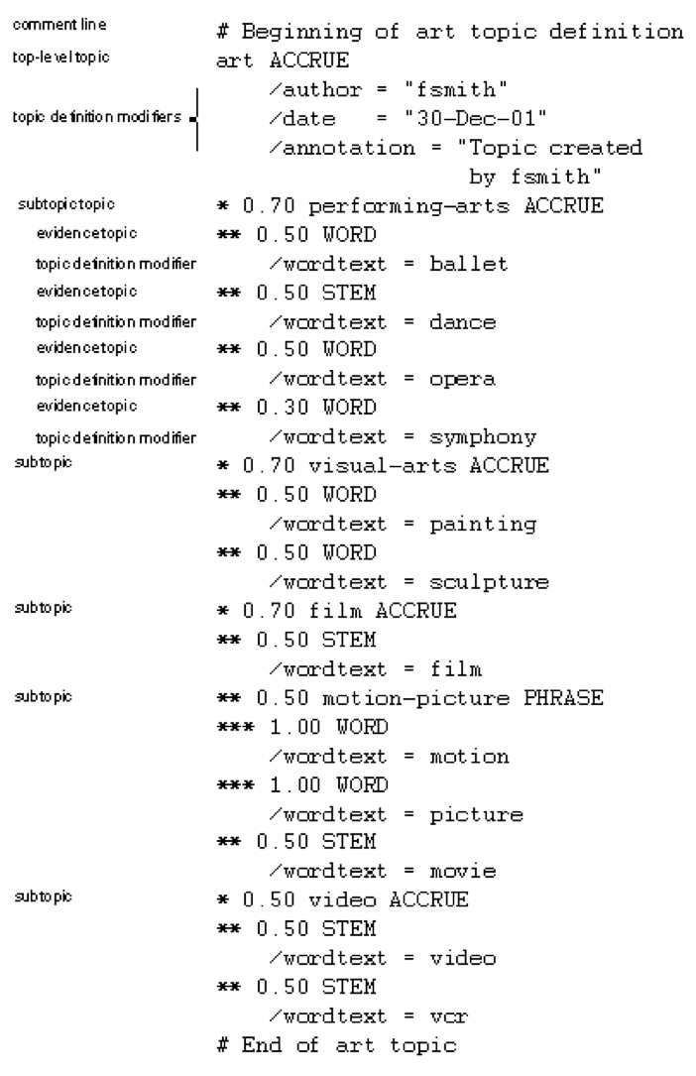
A Verity topic A complex classification rule
Introduction to Information Retrieval
Ch. 13
Note:
maintenance issues (author, etc.)
Hand-weighting of terms
[Verity was bought by Autonomy.]

Slide 14
Classification Methods (3)
Introduction to Information Retrieval
Ch. 13
Supervised learning of a document-label assignment function
Many systems partly or wholly rely on machine learning (Autonomy, Microsoft, Enkata, Yahoo!, …)
k-Nearest Neighbors (simple, powerful)
Naive Bayes (simple, common method)
Support-vector machines (generally more powerful)
DNN (new, most powerful)
… plus many other methods
No free lunch: requires hand-classified training data
But data can be built up (and refined) by amateurs
Many commercial systems use a mixture of methods

Slide 15
Relevance feedback
Introduction to Information Retrieval
In relevance feedback, the user marks a few documents as relevant/nonrelevant
The choices can be viewed as classes or categories
The IR system then uses these judgments to build a better model of the information need
So, relevance feedback can be viewed as a form of text classification (deciding between several classes)

Slide 16
Probabilistic relevance feedback
Introduction to Information Retrieval
Sec. 9.1.2
conditional probability of term occurring in a document of class
Rather than reweighting in a vector space…
If user has told us some relevant and some nonrelevant documents, then we can proceed to build a probabilistic classifier
such as the Naive Bayes model we will look at today:
P(t_{k}|R) = |D_{rk}| / |D_{r}|
P(t_{k}|NR) = |D_{nrk}| / |D_{nr}|
t_{k} is a term; D_{r} is the set of known relevant documents; D_{rk} is the subset that contain t_{k}; D_{nr} is the set of known nonrelevant documents; D_{nrk} is the subset that contain t_{k}.
conditional probability of term t_{k} occurring in a document of class ”Relevant”
----------------------------------------------------------------------------------------------------------
a measure of how much evidence contributes that ”Relevant” is the correct class

Slide 17
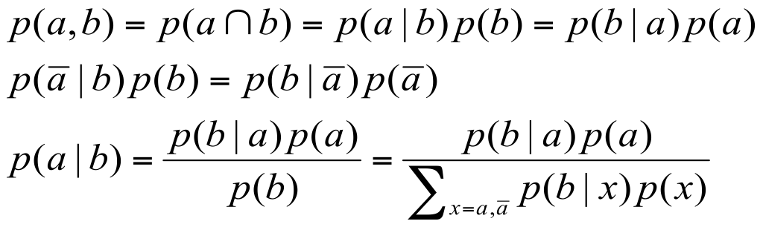
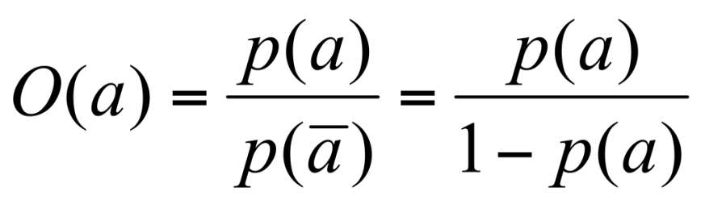
Recall a few probability basics
Introduction to Information Retrieval
For events a and b:
Bayes’ Rule
Odds:
Prior
Posterior

Slide 18
Bayesian Methods
Introduction to Information Retrieval
Sec.13.2
Learning and classification methods based on probability theory
Bayes theorem plays a critical role
Builds a generative model that approximates how data is produced
Has prior probability of each category given no information about an item.
Model produces a posterior probability
Distribution over the possible categories given an item
Naïve Bayes methods use a bag of words as the item description

Slide 19
The bag of words representation
Introduction to Information Retrieval
I love this movie! It's sweet, but with satirical humor. The dialogue is great and the adventure scenes are fun… It manages to be whimsical and romantic while laughing at the conventions of the fairy tale genre. I would recommend it to just about anyone. I've seen it several times, and I'm always happy to see it again whenever I have a friend who hasn't seen it yet.
γ(
)=c

Slide 20
Introduction to Information Retrieval
The bag of words representation
great | 2
love | 2
recommend | 1
laugh | 1
happy | 1
... | ...
γ(
)=c

Slide 21

Bayes’ Rule for text classification
Introduction to Information Retrieval
Sec.13.2
For a document d and a class c
P(c,d) = P(c|d)P(d) = P(d|c)P(c)
P(c|d) = $\frac{P\left(d | c\right)P(c)}{P(d)}$

Slide 22
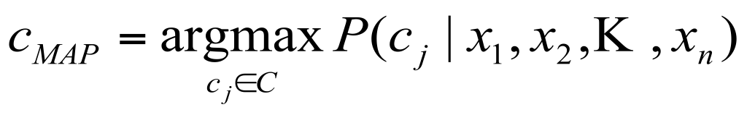
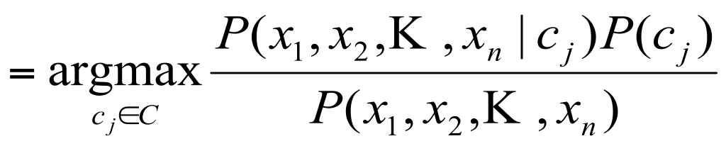
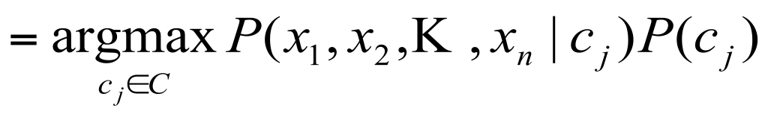
Naive Bayes Classifiers
Introduction to Information Retrieval
Sec.13.2
Task: Classify a new instance d based on a tuple of attribute values d = (X₁,X₂,…,X_{n}) into one of the classes c_{j} ∈ C
…
…
…
…
MAP is “maximum a posteriori” = most likely class

Slide 23
Naïve Bayes Classifier: Naïve Bayes Assumption
Introduction to Information Retrieval
Sec.13.2
P(c_{j})
Can be estimated from the frequency of classes in the training examples.
P(x₁,x₂,…,x_{n}|c_{j})
Could only be estimated if a very, very large number of training examples was available.
Naïve Bayes Conditional Independence Assumption:
Assume that the probability of observing the conjunction of attributes is equal to the product of the individual probabilities P(x_{i}|c_{j}).

Slide 24
The Multivariate Bernoulli NB Classifier
Introduction to Information Retrieval
Sec.13.3
Flu
X₁
X₂
X₃
X₄
X₅
runnynose
sinus
cough
fever
muscle-ache
Conditional Independence Assumption: features detect term presence and are independent of each other given the class:
This model is appropriate for binary variables
…
…

Slide 25
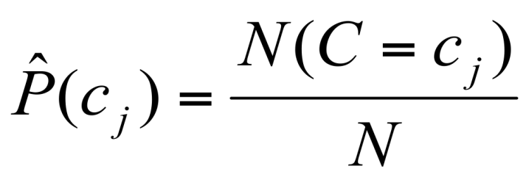
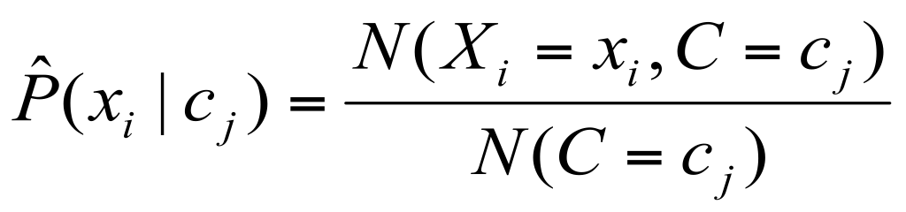
Learning the Model
Introduction to Information Retrieval
Sec.13.3
C
X₁
X₂
X₃
X₄
X₅
X₆
First attempt: maximum likelihood estimates
simply use the frequencies in the data
#documents belonging to c_{j}
#documents containing x_{i} and belonging to c_{j}

Slide 26
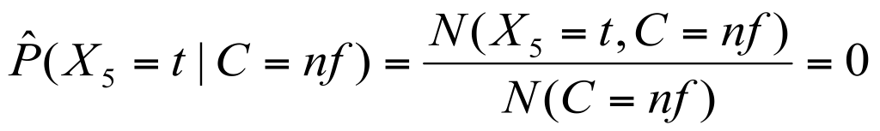
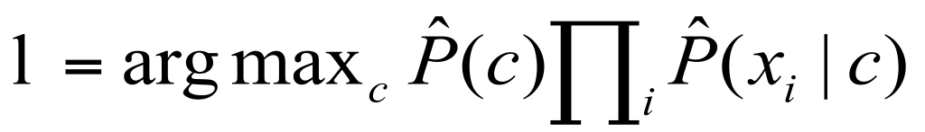
Problem with Maximum Likelihood
Introduction to Information Retrieval
Sec.13.3
Flu
X₁
X₂
X₃
X₄
X₅
runnynose
sinus
cough
fever
muscle-ache
…
…
What if we have seen no training documents with the word muscle-ache and classified in the topic Flu?
Zero probabilities cannot be conditioned away, no matter the other evidence!

Slide 27
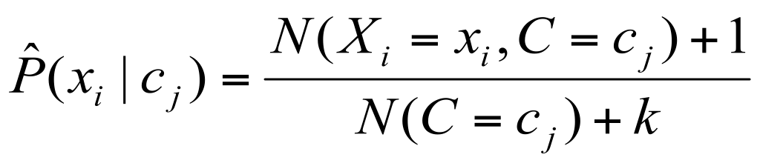
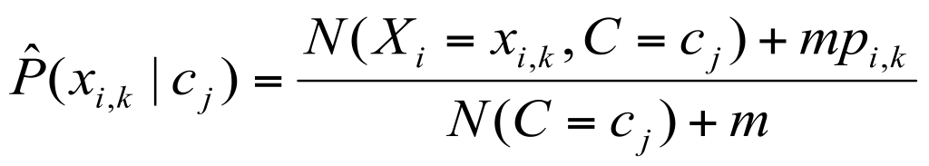
Smoothing to Avoid Overfitting
Introduction to Information Retrieval
Sec.13.3
# of values of X_{i} (# of terms)
overall fraction in data where X_{i}=x_{i,k}
Somewhat more subtle version
extent of
smoothing
Notes:
Add-one or Laplace smoothing
Uniform prior – each term occurs once for each class

Slide 28
Recap: language model
Intuition:
Human: coming up with good queries is to think of words that would likely appear in a relevant document
Idea: a document is a good match to a query if the document model is likely to generate the query, which will in turn happen if the document contains the query words often
Approach: builds a probabilistic language model M_{d} from each document d, and ranks documents based on the probability of the model generating the query: P(q|M_{d}).

Slide 29
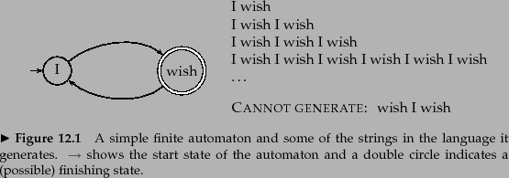

Recap: language model
The full set of strings that can be generated is called the language of the automaton.
If each node has a probability distribution over generating different terms, we have a language model.
A language model is a function that puts a probability measure over strings drawn from some vocabulary. That is, for a language model M over an alphabet Σ:

Slide 30
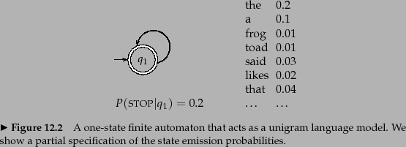

Recap: language model
Simple kind of language model – a probabilistic finite automaton consisting of just a single node with a single probability distribution over producing different terms, so that
After generating each word, we decide whether to stop or to loop around and then produce another word
so the model also requires a probability of stopping in the finishing state.
Such a model places a probability distribution over any sequence of words

Slide 31




Worked example
To find the probability of a word sequence, we just multiply the probabilities which the model gives to each word in the sequence, together with the probability of continuing or stopping after producing each word.
= =
Most of the time, we will omit to include STOP and (1 - STOP) probabilities (as do most other authors).

Slide 32
unigram model
Introduction to Information Retrieval
Sec.13.2.1
Model probability of generating strings (each word in turn) in a language (all strings over alphabet ∑).
Model M
0.2 the
0.1 a
0.01 man
0.01 woman
0.03 said
0.02 likes
…
the
man
likes
the
woman
0.2
0.01
0.02
0.2
0.01
multiply
P(s | M) = 0.00000008

Slide 33
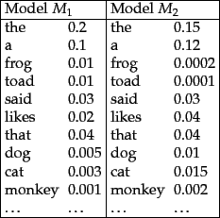
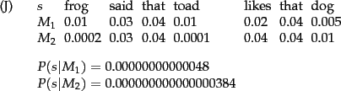
Ranking documents
Introduction to Information Retrieval
Sec.13.2.1
Model probability of generating any string
P(s|M₁) > P(s|M₂)

Slide 34
Unigram and higher-order models
Introduction to Information Retrieval
Sec.13.2.1
Unigram Language Models
Bigram (generally, n-gram) Language Models
Other Language Models
Grammar-based models (PCFGs), etc.
Probably not the first thing to try in IR
P ( )
= P ( )
P ( | )
P ( | )
P ( | )
bag-of-words
Easy.
Effective!
P ( ) P ( ) P ( ) P ( )
P ( ) P ( | ) P ( | ) P ( | )

Slide 35
Naïve Bayes via a class conditional language model = multinomial NB
Introduction to Information Retrieval
Sec.13.2
C
w₁
w₂
w₃
w₄
w₅
w₆
The probability of the words is done as a class-specific unigram language model
Notes:
Categorical distribution -- is a probability distribution that describes the result of a random event that can take on one of K possible outcomes, with the probability of each outcome separately specified.

Slide 36
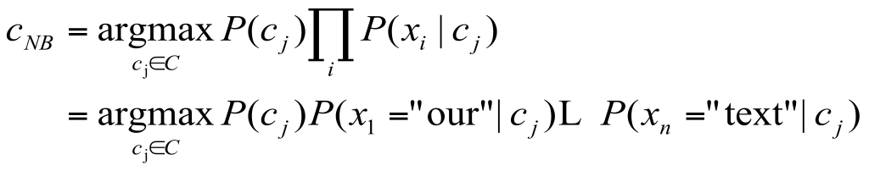
Using Multinomial Naive Bayes Classifiers to Classify Text: Basic method
Introduction to Information Retrieval
Sec.13.2
Attributes are text positions, values are words.
Still too many possibilities
Assume that classification is independent of the positions of the words
Use same parameters for each position
Result is bag of words model

Slide 37
Naive Bayes and Language Modeling
Introduction to Information Retrieval
Naïve Bayes classifiers can use any sort of feature
URL, email address, dictionaries, network features
But if, as in the previous slides
We use only word features
we use all of the words in the text (not a subset)
Then
Naïve Bayes is basically the same as language modeling
32

Slide 38
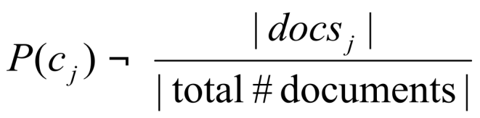
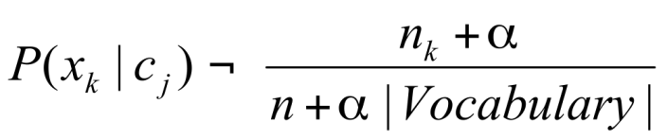
Multinomial Naive Bayes: Learning
Introduction to Information Retrieval
Sec.13.2
From training corpus, extract Vocabulary
Calculate required P(c_{j}) and P(x_{k} | c_{j}) terms
For each c_{j} in C do
docs_{j} is a subset of documents for which the target class is c_{j}
Text_{j} is a single document containing all docs_{j}
for each word x_{k} in Vocabulary
n_{k} is a number of occurrences of x_{k} in Text_{j}

Slide 39
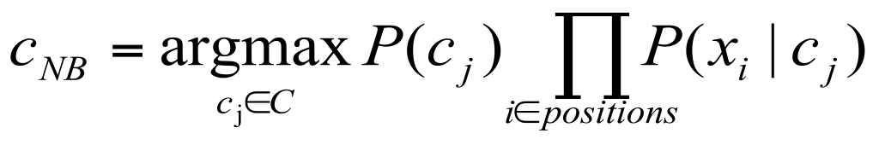
Naive Bayes: Classifying
Introduction to Information Retrieval
Sec.13.2
positions - all word positions in current document which contain tokens found in Vocabulary
Return c_{NB}, where

Slide 40
Naive Bayes: Time Complexity
Introduction to Information Retrieval
Sec.13.2
Training Time: O(|D|L_{ave} + |C||V|)) where L_{ave} is the average length of a document in D.
Assumes all counts are pre-computed in O(|D|L_{ave}) time during one pass through all of the data.
Generally just O(|D|L_{ave}) since usually |C||V| < |D|L_{ave}
Test Time: O(|C| L_{t}) where L_{t} is the average length of a test document.
Very efficient overall, linearly proportional to the time needed to just read in all the data.
Why?
Notes:
V – vocabulary
C - categories

Slide 41
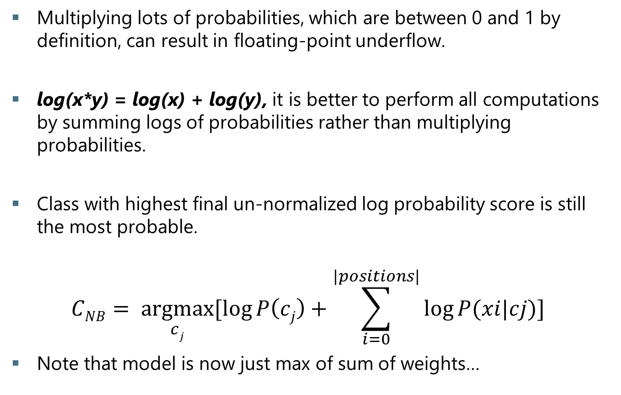
Underflow Prevention: using logs
Introduction to Information Retrieval
Sec.13.2
Multiplying lots of probabilities, which are between 0 and 1 by definition, can result in floating-point underflow.
log(x*y) = log(x) + log(y), it is better to perform all computations by summing logs of probabilities rather than multiplying probabilities.
Class with highest final un-normalized log probability score is still the most probable.
$$CNB= \underset{cj}{argmax}{[\log{P\left(cj\right)+\sum_{i=0}^{|positions|}{\log{P(xi|cj)}}}]}$$
Note that model is now just max of sum of weights…

Slide 42
Example
Introduction to Information Retrieval
 | Doc | Words | Class
Training | 1 | Chinese Beijing Chinese | c
 | 2 | Chinese Chinese Shanghai | c
 | 3 | Chinese Macao | c
 | 4 | Tokyo Japan Chinese | j
Test | 5 | Chinese Chinese Chinese Tokyo Japan | ?
37
Notes:
Alpha = 1

Slide 43
Two Naive Bayes Models
Introduction to Information Retrieval
Model 1: Multivariate Bernoulli
One feature X_{w} for each word in dictionary
for loop iterates over dictionary
X_{w} = true in document d if w appears in d
Naive Bayes assumption:
Given the document’s topic, appearance of one word in the document tells us nothing about chances that another word appears
Is used in the binary independence model (BIM) in classic probabilistic relevance feedback on hand-classified data

Slide 44
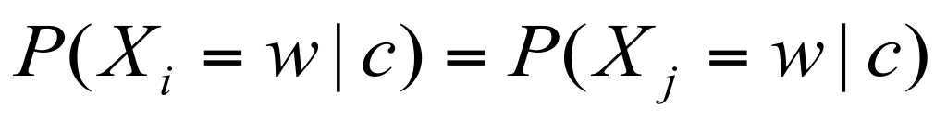
Two Models
Introduction to Information Retrieval
Model 2: Multinomial = Class conditional unigram
One feature X_{i} for each word position in document
feature’s values are all words in dictionary
Value of X_{i} is the word in position i
Naïve Bayes assumption:
Given the document’s topic, word in one position in the document tells us nothing about words in other positions
Second assumption:
Word appearance does not depend on position
for all positions i,j, word w, and class c

Slide 45
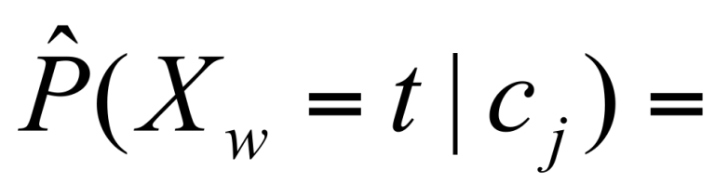
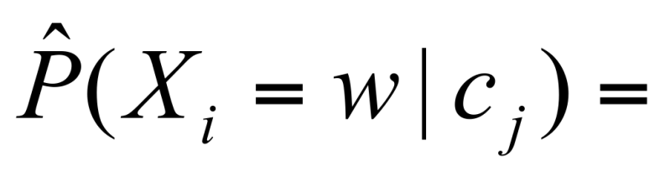
Parameter estimation
Introduction to Information Retrieval
Multivariate Bernoulli model:
Multinomial model:
Can create a mega-document for topic j by concatenating all documents in this topic
Use frequency of w in mega-document
fraction of documents of topic c_{j}
in which word w appears
fraction of times in which
word w appears among all
words in documents of topic c_{j}

Slide 46
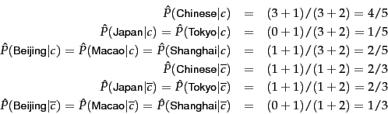




Example (multivariate)
Introduction to Information Retrieval
 | Doc | Words | Class
Training | 1 | Chinese Beijing Chinese | c
 | 2 | Chinese Chinese Shanghai | c
 | 3 | Chinese Macao | c
 | 4 | Tokyo Japan Chinese | j
Test | 5 | Chinese Chinese Chinese Tokyo Japan | ?
37
Notes:
Instead of going through all locations, we are going through all terms in vocabulary!
When looking only at binary occurrence and not at term frequency, Japan and Tokyo are indicators for J (2/3 > 1/5) and the conditional probabilities of Chinese for C and J are not different enough (4/5 vs. 2/3) to affect the classification decision.

Slide 47
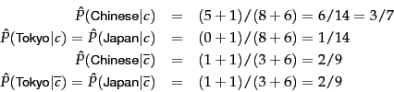

Example (multinomial)
Introduction to Information Retrieval
 | Doc | Words | Class
Training | 1 | Chinese Beijing Chinese | c
 | 2 | Chinese Chinese Shanghai | c
 | 3 | Chinese Macao | c
 | 4 | Tokyo Japan Chinese | j
Test | 5 | Chinese Chinese Chinese Tokyo Japan | ?
37
Notes:
Alpha = 1

Slide 48
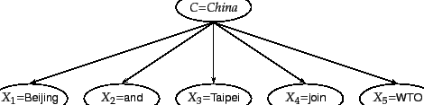
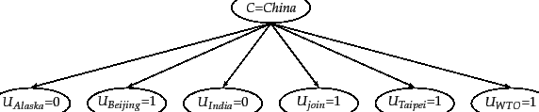
Multinomial vs Multivariate Bernoulli
Beijing and Taipei join WTO

Slide 49
Which to use for classification?
Introduction to Information Retrieval
Multinomial vs Multivariate Bernoulli?
Multinomial model (unigram) is almost always more effective in text applications!
See results figures later
There has been exploration of multinomial naïve bayes variants which often work better in practice
Binarized multinomial Naïve Bayes, etc.
Topic of PA4

Slide 50











Properties of NB
 | multinomial model | Bernoulli model
event model | generation of token | generation of document
random variable(s) | iff occurs at given pos | iff occurs in doc
document representation
parameter estimation
decision rule: maximize
multiple occurrences | taken into account | ignored
length of docs | can handle longer docs | works best for short docs
# features | can handle more | works best with fewer
estimate for term the

Slide 51
Sometimes NB independence assumptions are problematic
(1) | He moved from London, Ontario, to London, England.
(2) | He moved from London, England, to London, Ontario.
(3) | He moved from England to London, Ontario.

Slide 52
Feature Selection: Why?
Introduction to Information Retrieval
Sec.13.5
Text collections have a large number of features
10,000 – 1,000,000 unique words … and more
May make using a particular classifier feasible
Some classifiers can’t deal with 1,000,000 features
Reduces training time
Training time for some methods is quadratic or worse in the number of features
Makes runtime models smaller and faster
Can improve generalization (performance)
Eliminates noise features (OCR -> txt)
Avoids overfitting (arachnopet -> China)

Slide 53
Feature Selection: How?
Introduction to Information Retrieval
Sec.13.5
Two ideas for utility function A(t,c):
Hypothesis testing statistics:
Are we confident that the value of one categorical variable is associated with the value of another
Chi-square test (X²)
Information theory:
How much information does the value of one categorical variable give you about the value of another
Mutual information
They’re similar, but X² measures confidence in association, (based on available statistics), while MI measures extent of association (assuming perfect knowledge of probabilities)

Slide 54

X² statistic (CHI)
Introduction to Information Retrieval
Sec.13.5.2
X² tests independence of two events
A and B are independent iff
P(AB) = P(A)P(B) or P(A|B) = P(A) and P(B|A) = P(B)
Events in feature selection:
A – occurrence of the term,
B – occurrence of the class
Observed frequency in D
Expected frequency
of t and c occurring together assuming that term and class are independent
If N and E are close => X² is small => term and class are independent

Slide 55
















Example. RCV1
N = N₁₁+N₀₁+N₁₀+N₀₀=801,948
expected
observed
=
=
How much E deviates from N?
we can reject the hypothesis that poultry and export are independent
with only a 0.001 chance of being wrong
Notes:
A high value of X² indicates that the hypothesis of independence, which implies that expected and observed counts are similar, is incorrect.

Slide 56


Critical values of the X² distribution
P | critical value
0.1 | 2.71
0.05 | 3.84
0.01 | 6.63
0.005 | 7.88
0.001 | 10.83
if the two events are independent, then
So for the assumption of independence
can be rejected with 99% confidence.

Slide 57

Introduction to Information Retrieval
Sec.13.5.2
X² statistic (CHI)
There is a simpler formula for 2x2 X² :
A = #(t,c)
C = #(¬t,c)
B = #(t,¬c)
D = #(¬t, ¬c)
N = A + B + C + D

Slide 58
MI in Information Theory
MI measures how much information - in the information-theoretic sense - a term contains about the class.
If a term's distribution is the same in the class as it is in the collection as a whole, then I(w,c) = 0.
I(X; Y) = 0 if and only if X and Y are independent random variables.
if X and Y are independent, then p(x,y) = p(x) p(y)
MI reaches its maximum value if the term is a perfect indicator for class membership, that is, if the term is present in a document if and only if the document is in the class.

Slide 59
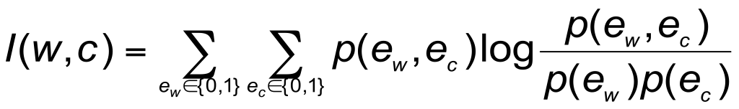
Feature selection via Mutual Information
Introduction to Information Retrieval
Sec.13.5.1
In training set, choose k words which best discriminate (give most info on) the categories.
The Mutual Information between a word w, class c is:
For each word w and each category c

Slide 60
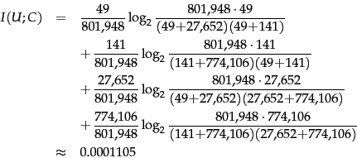
Example, RCV1

Slide 61
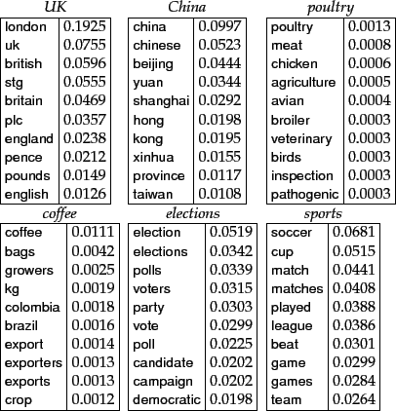
Feature selection via MI (contd.)
Introduction to Information Retrieval
Sec.13.5.1
For each category we build a list of k most discriminating terms.
Greedy
Example: features with
high MI scores for
six Reuters-RCV1
classes

Slide 62
Feature Selection
Introduction to Information Retrieval
Sec.13.5
Mutual Information
Clear information-theoretic interpretation
May select rare uninformative terms
Chi-square
Statistical foundation
May select very slightly informative frequent terms that are not very useful for classification
Frequency

Slide 63
Feature Selection: Frequency
Introduction to Information Retrieval
The simplest feature selection method:
Just use the commonest terms
No particular foundation
But it make sense why this works
They’re the words that can be well-estimated and are most often available as evidence
In practice, this is often 90% as good as better methods
49

Slide 64
Feature selection for NB
Introduction to Information Retrieval
Sec.13.5
In general feature selection is necessary for multivariate Bernoulli NB.
Otherwise you suffer from noise, multi-counting
“Feature selection” really means something different for multinomial NB. It means dictionary truncation
The multinomial NB model only has 1 feature
This “feature selection” normally isn’t needed for multinomial NB
Unless we want to concentrate on “specific parts” of a document

Slide 65
Evaluating Categorization
Introduction to Information Retrieval
Sec.13.6
Evaluation must be done on test data that are independent of the training data (usually a disjoint set of instances).
Sometimes use cross-validation (averaging results over multiple training and test splits of the overall data)
It’s easy to get good performance on a test set that was available to the learner during training (e.g., just memorize the test set).
Measures: precision, recall, F1, classification accuracy
Classification accuracy: c/n where n is the total number of test instances and c is the number of test instances correctly classified by the system.
Adequate if one class per document
Otherwise F measure for each class

Slide 66
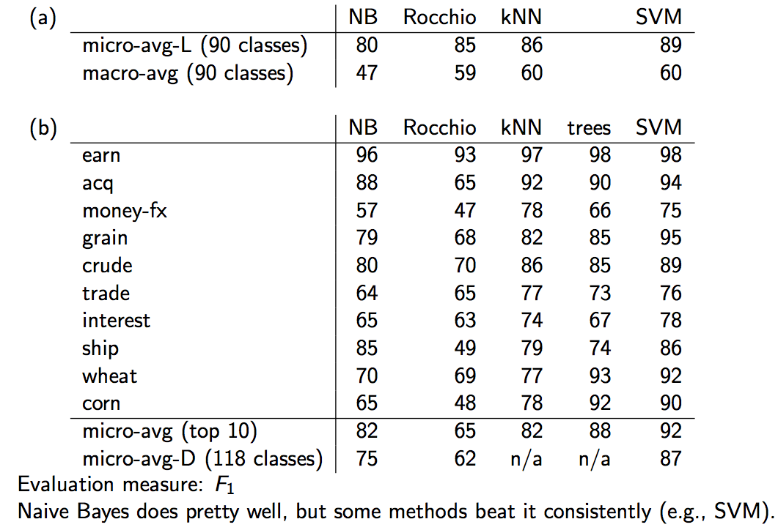
Naive Bayes vs. other methods
Introduction to Information Retrieval
Sec.13.6
52

Slide 67
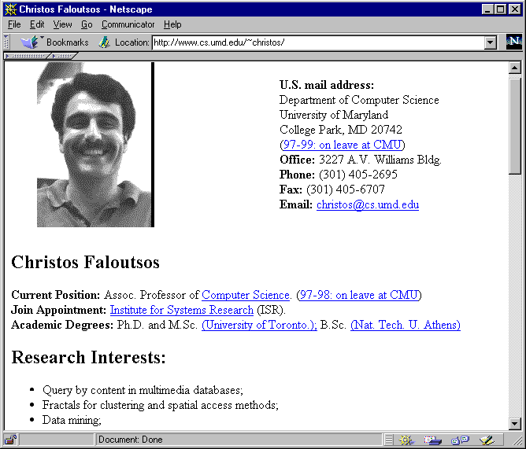

WebKB Experiment (1998)
Introduction to Information Retrieval
Sec.13.6
Classify webpages from CS departments into:
student, faculty, course,project
Train on ~5,000 hand-labeled web pages
Cornell, Washington, U.Texas, Wisconsin
Crawl and classify a new site (CMU)
Results:

Slide 68
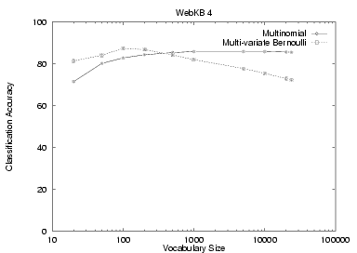
NB Model Comparison: WebKB
Introduction to Information Retrieval
Sec.13.6

Slide 69
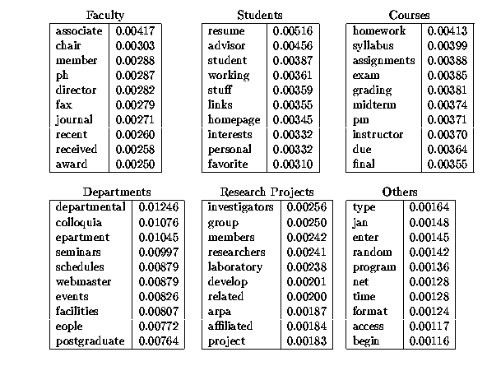
Introduction to Information Retrieval

Slide 70
SpamAssassin
Introduction to Information Retrieval
Naïve Bayes has found a home in spam filtering
Paul Graham’s A Plan for Spam
A Naive Bayes-like classifier with weird parameter estimation
Widely used in spam filters
But many features beyond words:
black hole lists, etc.
particular hand-crafted text patterns

Slide 71
Naïve Bayes in Spam Filtering
Introduction to Information Retrieval
SpamAssassin Features:
Basic (Naïve) Bayes spam probability
Mentions: Generic Viagra
Mentions millions of (dollar) ((dollar) NN,NNN,NNN.NN)
Phrase: impress ... girl
Phrase: 'Prestigious Non-Accredited Universities’
From: starts with many numbers
Subject is all capitals
HTML has a low ratio of text to image area
Relay in RBL, http://www.mail-abuse.com/enduserinfo_rbl.html
RCVD line looks faked
http://spamassassin.apache.org/tests_3_3_x.html

Slide 72
Example: Sensors
Introduction to Information Retrieval
Reality
Raining
Sunny
P(+,+,r) = 3/8
P(-,-,r) = 1/8
P(+,+,s) = 1/8
P(-,-,s) = 3/8
NB Model
NB FACTORS:
P(s) = 1/2
P(+|s) = 1/4
P(+|r) = 3/4
PREDICTIONS:
P(r,+,+) = (½)(¾)(¾)
P(s,+,+) = (½)(¼)(¼)
P(r|+,+) = 9/10
P(s|+,+) = 1/10
Raining?
M1
M2

Slide 73
Naïve Bayes Posterior Probabilities
Introduction to Information Retrieval
Classification results of naïve Bayes (the class with maximum posterior probability) are usually fairly accurate.
However, due to the inadequacy of the conditional independence assumption, the actual posterior-probability numerical estimates are not.
Output probabilities are commonly very close to 0 or 1.
Correct estimation = accurate prediction, but correct probability estimation is NOT necessary for accurate prediction (just need right ordering of probabilities)

Slide 74
Naive Bayes is Not So Naive
Introduction to Information Retrieval
Very Fast Learning and Testing (basically just count the data)
Low Storage requirements
Very good in domains with many equally important features
More robust to irrelevant features than many learning methods
Irrelevant Features cancel each other without affecting results
More robust to concept drift (changing class definition over time)
Naive Bayes won 1st and 2nd place in KDD-CUP 97 competition out of 16 systems
Goal: Financial services industry direct mail response prediction: Predict if the recipient of mail will actually respond to the advertisement – 750,000 records.
A good dependable baseline for text classification (but not the best)!

Slide 75
Resources for today’s lecture
Introduction to Information Retrieval
Ch. 13
IIR 13
Fabrizio Sebastiani. Machine Learning in Automated Text Categorization. ACM Computing Surveys, 34(1):1-47, 2002.
Yiming Yang & Xin Liu, A re-examination of text categorization methods. Proceedings of SIGIR, 1999.
Andrew McCallum and Kamal Nigam. A Comparison of Event Models for Naive Bayes Text Classification. In AAAI/ICML-98 Workshop on Learning for Text Categorization, pp. 41-48.
Tom Mitchell, Machine Learning. McGraw-Hill, 1997.
Clear simple explanation of Naïve Bayes
Open Calais: Automatic Semantic Tagging
Free (but they can keep your data), provided by Thompson/Reuters (ex-ClearForest)
Weka: A data mining software package that includes an implementation of Naive Bayes
Reuters-21578 – the most famous text classification evaluation set
Still widely used by lazy people (but now it’s too small for realistic experiments – you should use Reuters RCV1)

